Slide 1
Employee Data Analysis using Excel
STUDENT NAME: TEJUS M
REGISTER NO: 312216404 ID:asunm1621312216404
DEPARTMENT: B.com Computer Applications
COLLEGE: Shri Shankarlal Sundarbai Shasun Jain
college for Women’s

Slide 2
PROJECT TITLE
Employee Performance Analysis using Excel

Slide 3


AGENDA
Problem Statement
Project Overview
End Users
Our Solution and Proposition
Dataset Description
Modelling Approach
Results and Discussion
Conclusion
3/21/2024 Annual Review

Slide 4

PROBLEM STATEMENT
Identifying High Performers and Low Performers: The existing metrics and evaluation methods do not adequately distinguish between improve high and low performers or provide actionable insights on how to the performance of those struggling.
Understanding Performance Drivers: There is limited understanding of the key drivers behind employee performance, including factors such as motivation, work environment, management practices, and personal competencies.
Providing Constructive Feedback: Managers face difficulties in delivering specific, actionable feedback to employees due to a lack of detailed performance analysis, leading to ineffective performance improvement plans.
Aligning Performance with Organizational Goals: There is a disconnect between individual performance and broader organizational objectives, making it challenging to ensure that employee efforts are aligned with the company's strategic goals.
Employee Development and Retention: Without clear performance insights, the organization finds it challenging to develop personalized training and development programs, impacting employee growth and retention.

Slide 5

PROJECT OVERVIEW
Objective: To evaluate and enhance employee performance through comprehensive data analysis, aiming to improve productivity, satisfaction, and organizational effectiveness.
Key Components:
Data Collection:
Gather quantitative and qualitative data on employee performance through surveys, performance reviews, productivity metrics, and peer feedback.
Analysis:
Use statistical methods and data analytics tools to identify performance trends, strengths, and areas for improvement.
Insights & Recommendations:
Develop actionable insights based on the analysis to address performance gaps and leverage strengths.
Implementation:
Collaborate with HR and management to implement recommendations.
Develop strategies for continuous performance monitoring and feedback.
Evaluation:
Assess the impact of implemented changes on employee performance.
Adjust strategies based on feedback and performance outcomes to ensure ongoing improvement.

Slide 6

WHO ARE THE END USERS?
Managers: They use performance analysis to evaluate team members' contributions, identify strengths and areas for improvement, and make decisions related to promotions, rewards, and development opportunities.
Team Leaders: Similar to managers, team leaders rely on performance data to monitor and guide the progress of their teams, set clear expectations, and provide targeted feedback to enhance individual and group performance.
HR Professionals: Human Resources teams use performance analysis to inform recruitment strategies, design training programs, and manage employee relations. They also use this data to ensure fair and equitable treatment in performance evaluations and compensation.
Executives: Senior leaders and executives review performance data to assess overall organizational health, align employee performance with strategic goals, and make high-level decisions about resource allocation and business direction.
Employees: Individuals may also be end users of performance analysis, as they can access their own performance data to understand their achievements, set personal goals, and engage in self-improvement efforts.

Slide 7

OUR SOLUTION AND ITS VALUE PROPOSITION
Our Excel-based employee performance analysis solution provides businesses with a cost-effective and customizable tool for tracking and evaluating key performance metrics.
It automates KPI calculations, visualizes data through dynamic dashboards, and delivers actionable insights for informed decision-making. By fostering transparency, accountability, and real-time performance monitoring, this solution enhances productivity, identifies areas for improvement, and supports effective employee management, all within a familiar and scalable platform.

Slide 8
Dataset Description
The dataset for the "Employee Performance Analysis using Excel" project contains essential metrics for evaluating employee performance. It includes basic details like Employee ID, Name, Department, and Position, along with critical performance indicators such as attendance records, project completion rates, and quality of work. Additionally, it captures peer and managerial feedback scores, providing a well-rounded view of each employee’s contributions. The dataset also tracks training hours and any promotions or awards received, offering insights into professional development and recognition. This data is structured to enable effective analysis using Excel, allowing management to identify top performers, address areas needing improvement, and make informed decisions about employee development and rewards. Overall, this dataset serves as a foundation for creating a comprehensive performance analysis tool in Excel.

Slide 9

THE "WOW" IN OUR SOLUTION
The "wow" factor in our employee performance analysis solution lies in its ability to go beyond basic metrics and uncover deep, actionable insights that drive real business impact. Unlike traditional performance evaluations that often rely on surface-level data, our solution integrates advanced analytics, machine learning algorithms, and predictive modeling to provide a holistic view of employee performance.
It doesn't just assess how employees are performing; it also identifies why they perform the way they do and predicts future performance trends. This includes pinpointing the exact factors that contribute to high performance, recognizing early signs of disengagement, and even suggesting personalized development plans for each employee. Our solution is designed to be intuitive and user-friendly, providing interactive dashboards and visualizations that allow HR teams and managers to easily interpret data and make informed decisions quickly.
3/21/2024 Annual Review
9

Slide 10

MODELLING
Our employee performance analysis model in Excel transforms raw data into actionable insights by using structured data input, KPI calculations, and powerful visualizations. First, performance data—such as attendance, sales, task completion, and customer ratings—is organized into a table. Each metric is calculated using weighted formulas to provide a final performance score for each employee. Excel's visualization tools, such as bar charts, line graphs, and conditional formatting, are then used to compare and highlight performance trends. The model also features interactive dashboards that give managers real-time insights into individual and team performance, helping to quickly identify top performers and areas for improvement. This efficient and customizable approach makes employee performance analysis both accessible and impactful.
10

Slide 11
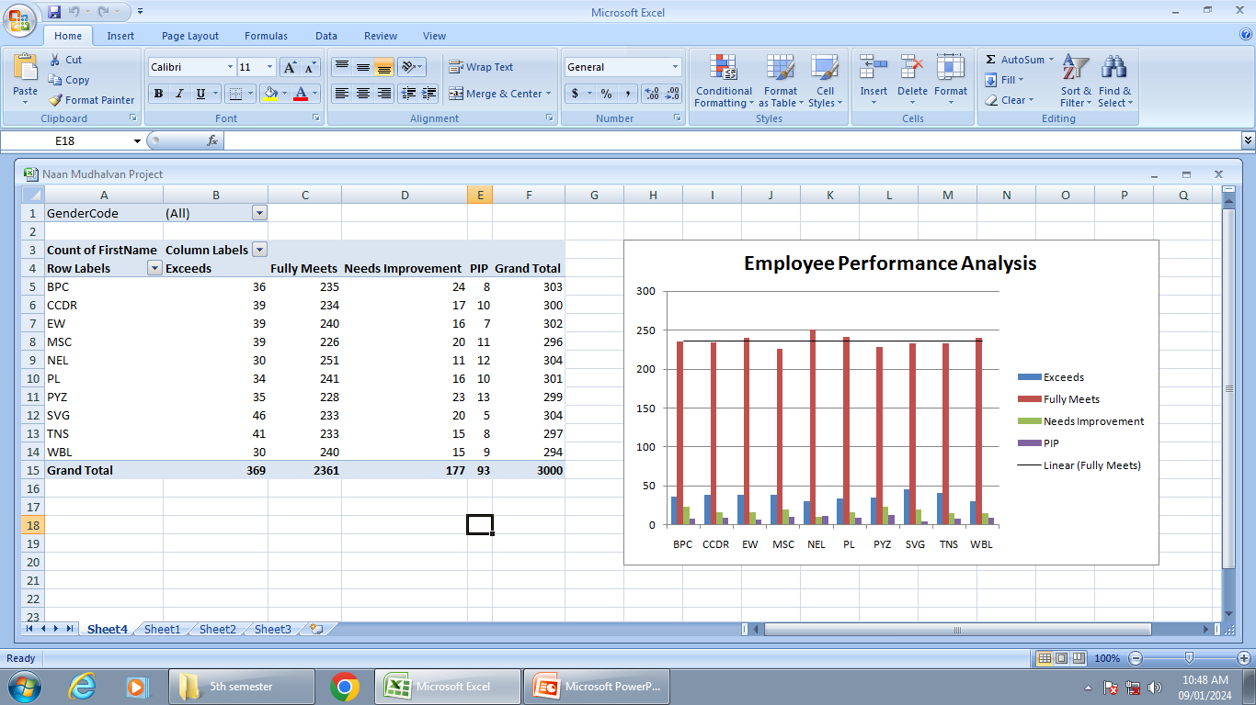

RESULTS
11

Slide 12
conclusion
Employee performance analysis using Excel provides businesses with a cost-effective, flexible, and powerful tool to measure and improve workforce productivity. Through structured data collection, KPI calculations, and insightful visualizations, companies can gain
a clear understanding of individual and team performance.
Excel's familiar interface, combined with its robust analytical features, allows for real-time monitoring, transparent reporting, and data-driven decision-making. By leveraging this solution, organizations can identify top performers, target areas for improvement, and ultimately foster a more productive, motivated, and efficient workforce, all without the need for expensive or complex software systems.

